Slide 1
Web Application Development With Java CEJV 559
Week 01
Course Overview

Slide 2

Your Instructor
Ken Fogel
Chairperson & Program Coordinator
Computer Science Technology
Dawson College
Java Champion
kenneth.fogel@concordia.ca
Always include the course number, CEJV 559, in the subject line of emails that you send me

Slide 3
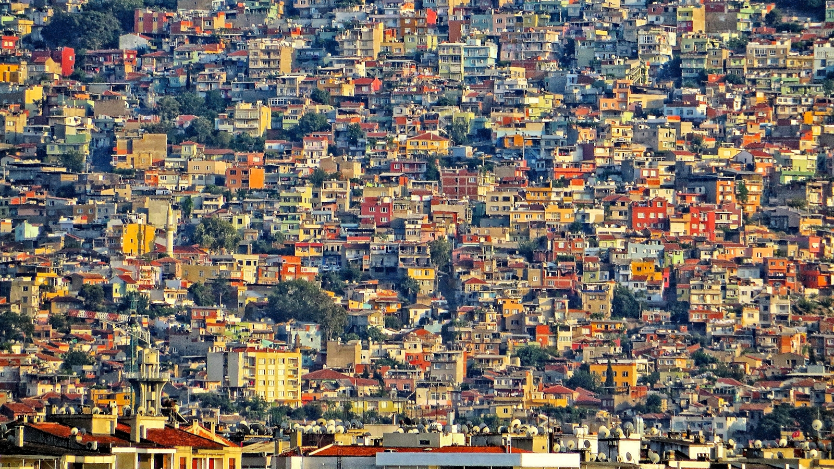
The world wide web is a very crowded space.
Taken July 6, 2013. A hillside in Izmir, Turkey

Slide 4
Lets Go Over The Course Outline

Slide 5
The development environment

Slide 6
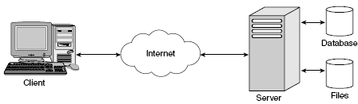
The Web Application

Slide 7
Components of a Web Application
Web applications are a type of client/server application.
A user at a client computer accesses an application at a server computer.
The client and server computers are connected via the Internet or an intranet.
The web browser provides the user interface for the application and some processing using JavaScript.
A web application runs on the server computer under the control of web server application.
For most web applications, the server computer also runs a database management system (DBMS).

Slide 8
Static Web Pages
An HTML document that’s stored in a file and does not change in response to user input.
Hypertext Transfer Protocol, or HTTP, is the protocol that web browsers and web servers use to communicate.
A web browser requests a page from a web server by sending the server a message known as an HTTP request.
A web server replies to an HTTP request by sending a message known as an HTTP response back to the browser.
By GgiaEsquema-proxy-internet.svg: Randomicc - Own work, CC BY-SA 3.0, https://commons.wikimedia.org/w/index.php?curid=19280407

Slide 9
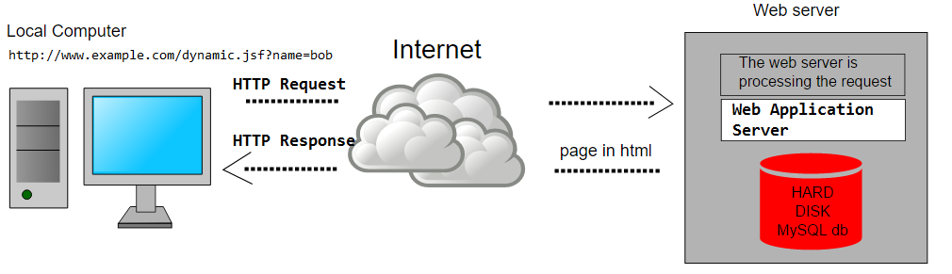
Dynamic Web Pages
Web page changes according to parameters that are sent to the web application by the web browser
When a web server receives a request for a dynamic web page the server passes the request to an application server
Application running on the server generates a response usually as an HTML document
The web server wraps the generated HTML document in an HTTP response and sends it back to the browser.
By Ggia Esquema-proxy-internet.svg: Randomicc (Own work) [CC BY-SA 3.0 (http://creativecommons.org/licenses/by-sa/3.0)], via Wikimedia Commons

Slide 10
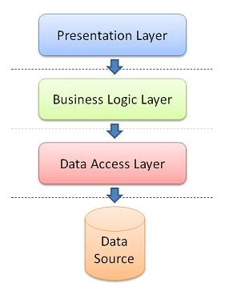
Java Dynamic Web Architecture

Slide 11
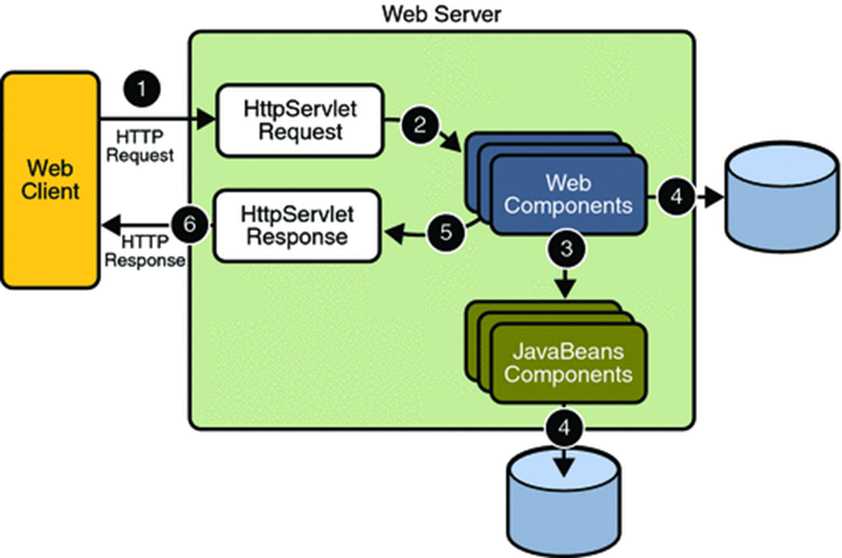
Java Web Application Request Handling

Slide 12
Server Classification
Web Server
A server that delivers static content
Modern web servers can also support scripting engines such as PHP and Python
Application Server
Typically a web server that provides additional services other than delivering static content
Services include executing Java or .Net code, hosting web services and providing database functions
Also referred to as middleware servers

Slide 13
Servers
Apache httpd (C - Apache)
Widely used traditional server
Embedded version used in many applications
The most widely used web server, barely
Nginx (C)
Open Source
Event driven rather than threaded (httpd) web server
Currently the #2 web server but expected to surpass httpd soon
Microsoft IIS (C/C++ - Microsoft)
A full stack application server
Integrated with the .Net platform and SQL Server

Slide 14
Servers
Tomcat (Java – Apache)
A server dedicated to Java server side programming
Can deliver static HTML but cannot support scripting languages
Supports the servlet and JavaServer Pages programming model
TomEE (Java – Apache)
Java EE 6 introduced the Web Profile
Many features previously available only in a full blown application server are part of the Web Profile
TomEE is Tomcat with additional libraries to meet the Web Profile

Slide 15
Servers
WebLogic (Oracle)
Full stack application server supporting JEE 8
Oracle’s application server with commercial support
Highly integrated with Oracle DB
WildFly (RedHat)
Full stack application server supporting JEE 8
Open source version of Red Hat commercial server
WebSphere (IBM)
Full stack application server supporting JEE 8

Slide 16
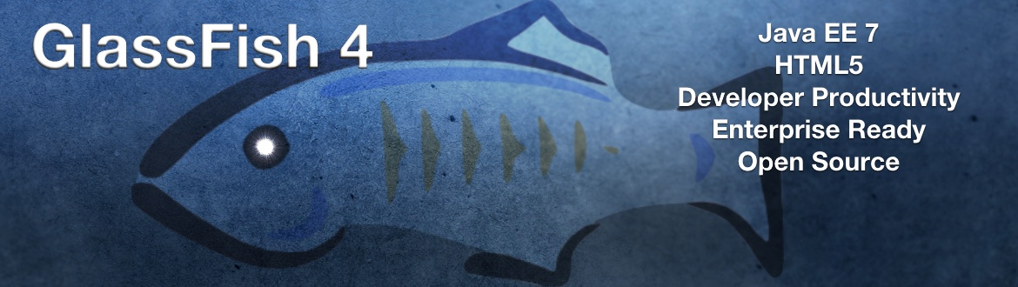
Servers
Glassfish (Oracle)
Reference implementation of a JEE server
Open source applications server
Full stack application server supporting JEE 8
Oracle no longer provides commercial support

Slide 17

Servers
Payara
Derived from GlassFish Server
Updated regularly
Provides commercial support
Remains an open source project and free to download and use

Slide 18
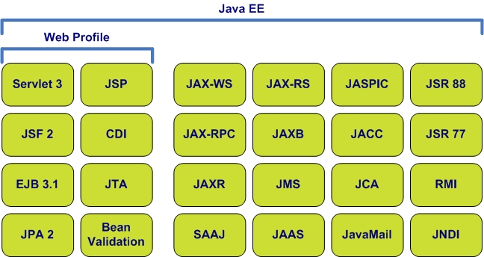
Java Web Profile

Slide 19
Servlets and JavaServer Pages
Servlet 4.0 and JSP
Original Java server side programming model
Servlets take on the role of controller
JavaServer pages take on the role of the view or presentation
Java bean style classes take on the role of data
This programming style is considered to be low-level today

Slide 20
JavaServer Faces
JSP 2.3
Framework that is built upon Servlet technology
Uses context and dependency injection
Presentation layer is based on components called Facelets that represent user interface elements in the browser
Additional component libraries such as PrimeFaces add to the functionality
Easily implements AJAX functionality
Goal is to allow the programmer to focus on the business logic rather than the plumbing

Slide 21
Java Persistence API
JPA 2.2
Object oriented alternative to JDBC
Object Relational Mapping tools to generate classes based on database schemas
Generates access classes for a mapped database
Uses a variant of SQL called the Java Persistence Query Language
JPQL works with objects as parameters to queries and returns objects rather than result sets
Supports object oriented queries with Criteria object

Slide 22
Maven
We will use maven for the build and test management of our projects
Projects use a pom.xml to describe their dependencies
Resolves issues concerning the availability of libraries
To use the Arquillian testing framework we must create maven projects
You will be provided with a project template for all assignments

Slide 23
Arquillian Testing
JUnit testing cannot be done on CDI objects
Arquillian handles all the plumbing of container management, deployment and framework initialization
Integrates with JUnit
Testing at the browser level is outside the scope of this course
If you are interested in this then look into Selenium, a tool that lets you write scripts that run in a browser to interact with the user interface

Slide 24
The Current Status of Java Enterprise Edition
Oracle released Java EE 8 in September
Announced that this will be the last version under Oracle stewardship
Oracle assigned Java EE to the Eclipse Foundation where its now officially named Jakarta EE
There had been many complaints that Oracle was not responsive to suggestions made by the community
In the hands of Eclipse it is expected to better reflective of the community’s needs
Oracle has also given NetBeans to the Apache Foundation
In both cases Oracle will continue to fund development for a few more years.

